Slide 1
Neuro-Symbolic AI
CPSC 677 Murori Mutuma 10/08/2020

Slide 2
Overview
History of AI approaches
Neuro- Symbolic AI
Paper
Review
Discussion Questions

Slide 3
History of
AI approaches

Slide 4

Quick Background
Different approaches to AI: including Symbolic AI and Neural Networks
Both Symbolic AI and Neural networks were started in the 1960s.
Both have undergone AI winters.
Symbolic AI gained success in the 70 - 90s but struggled since then.
Neural networks were largely dismissed because they were inefficient and required compute resources that weren’t available at the time.
Both have had a lot to gain from increased computing power.
Neural net approach is currently the most dominant approach in the field.
Image source

Slide 5
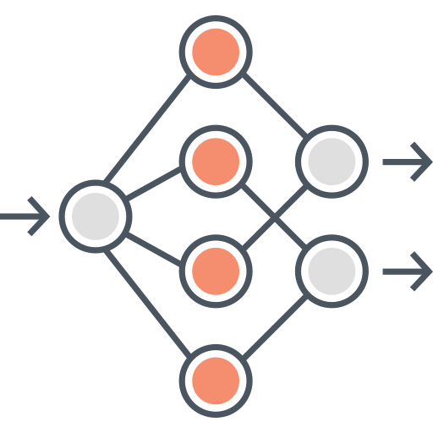
Neural Networks
A Connectionist Approach

Slide 6
Neural Networks Aliases: “Deep Learning” and “Connectionist AI”.
Gained popularity due to large availability of data and processing power.
The advantage of neural networks is that they can deal with messy and unstructured data such as computer vision and language-related tasks.
Deep neural networks are also very suitable for reinforcement learning suitable for game playing and other tasks.
Deep learning algorithms are opaque, and figuring out how they work perplexes even their creators.
Require a lot of data and computing power to train.
Notes:
Recognizing image of cat
Perform tasks such as higher tasks such as sports analysitics and medical imaging, cancer detection systems

Slide 7
Neural Networks
Advantages
Easily scalable.
Works well with messy real-world data.
Allows for reinforcement learning.
Great with images, video and multimedia data.
Disadvantages
Require large amounts of data to train.
Opaque and difficult to debug.
Cannot reason or perform complex logic.
Difficult generalizing and abstracting.
Vulnerable to hacking via adversarial examples.
Perpetuate bias in the training data.

Slide 8
Symbolic AI

Slide 9
Inspiration for the Symbolic Approach
We use symbols all the time to define things (cat, car, airplane, etc.) and people (teacher, police, salesperson).
Symbols can represent abstract concepts (bank transaction) or things that don’t physically exist (web page, blog post, etc.).
They can also describe actions (running) or states (inactive).
Symbols can be organized into hierarchies (a car is made of doors, windows, tires, seats, etc.).
They can also be used to describe other symbols (a cat with fluffy ears, a red carpet, etc.).
Being able to communicate in symbols is one of the main things that make us intelligent.
Therefore, symbols have also played a crucial role in the creation of artificial intelligence.

Slide 10
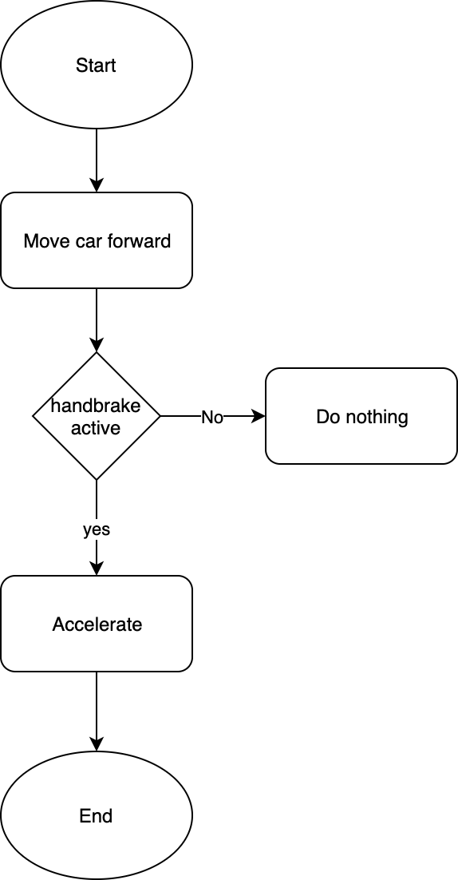
Symbolic AI Aliases: “classical AI,” “rule-based AI,” and “good old-fashioned AI”
Symbolic program gained prominence from mid-1950s to late 1980s.
Symbols play a vital role in the human thought and reasoning process.
Involves explicit embedding of human knowledge and rules into computer programs.
Gave rise to expert systems used in tasks such as medical diagnosis.
Example of symbolic AI tools is object-oriented programming. OOP languages allow you to define classes, specify their properties, and organize them in hierarchies.
Breaks down when you must deal with the messiness of the world. For instance, consider computer vision.
Image source
Notes:
Cat images

Slide 11
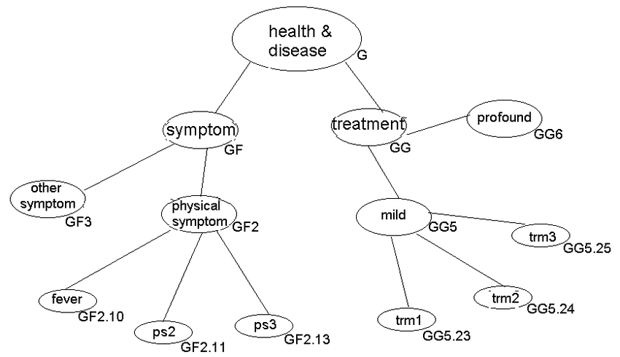
Classic Symbolic Systems
Knowledge representation
Include semantic nets, knowledge bases, systems architecture, frames, rules, and ontologies.
Examples: CYC project, ConceptNet, Semantic Web, FreeBase
Knowledge reasoning systems
Include inference engines, theorem provers, and classifiers.
Examples: MYCIN
Allows for reasoning through:
Forward chaining starting with the available data and uses inference rules to extract more data (from an end user, for example) until a goal is reached.
Backward chaining starting with the goal and using available data and uses inference rules to extract more data.
Expert systems used in narrow domains.
Image source

Slide 12
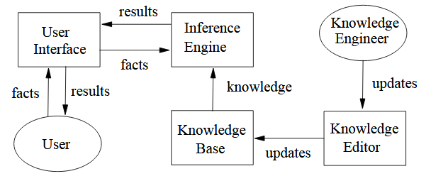
Expert Systems
Involves extensive knowledge acquisition from experts.
Contains two distinct parts:
Knowledge base
Inference engine
Covered narrow domains.
Had limited learning.
Were quite brittle as they dealt poorly with edge-cases.
Image source

Slide 13
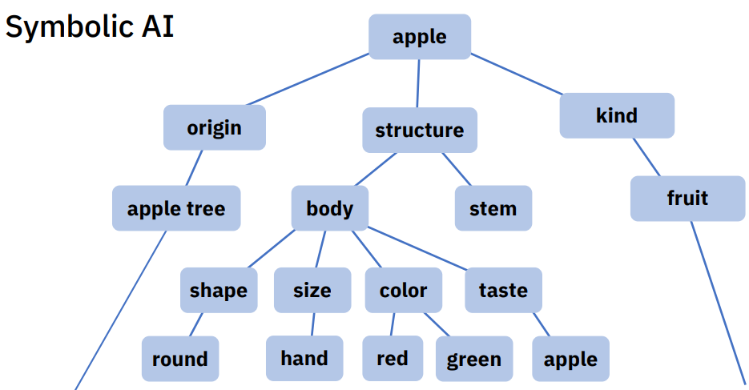
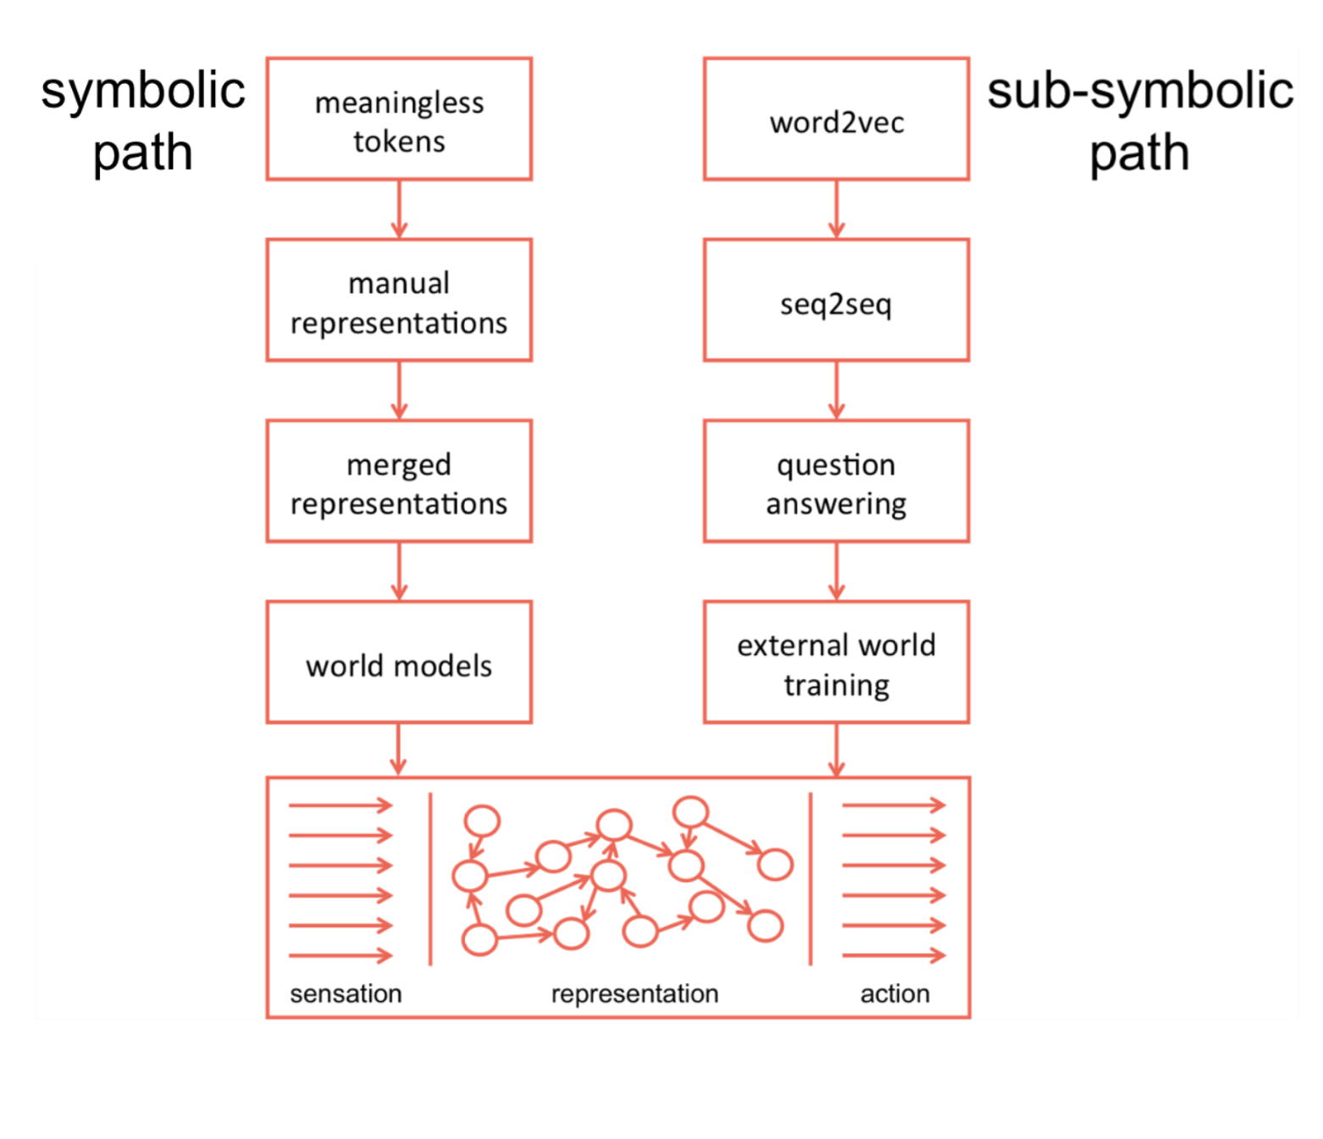
Symbolic NLP
Segment text into meaningless tokens that correspond to words and punctuation.
Manually create representations that assign meanings to these tokens by putting them into groups and creating relationships between the groups.
With those representations, we build a model of how the world works, and we ground that model in the manually created representations.
Image source
Image source

Slide 14
Applications of
Symbolic systems
Digitals assistants e.g Siri
Conversational programs e.g ELIZA
Search engines e.g Google Search using Google Knowledge Graph
Games. e.g Pac-Man, IBM’s Deep Blue taking down chess champion Kasparov
Automatic interface systems e.g TurboTax

Slide 15
Symbolic AI
Advantages
Can perform reasoning and complex logic.
Transparent and debuggable.
Less susceptible to implicit bias.
Disadvantages
Not readily scalable.
Cannot handle messy data such as computer vision.
Expert systems require a lot of experts to hard code the rules.
Explosion in number of rules to handle the edge cases.
More rules may lead to drop in accuracy

Slide 16

Neuro-Symbolic AI
Best of both worlds?

Slide 17
Motivation for the Neuro-Symbolic approach
 | Neural | Symbolic
Easily Scalable | Yes | No
Successful with images and multimedia data? | Yes | No
Appropriate for messy data? | Yes | No
Reasoning | No | Yes
Explainable and debuggable | No | Yes
Few shot learning | No | Yes
Notes:
It’s a problem when (spotify) you are denied a loan or involved in an accident.

Slide 18
Motivation for the Neuro-Symbolic approach
 | Neural | Symbolic | Neuro-Symbolic
Easily Scalable | Yes | No | Yes
Successful with images and multimedia data? | Yes | No | Yes
Appropriate for messy data? | Yes | No | Yes
Reasoning | No | Yes | Yes
Explainable and debuggable | No | Yes | Yes
Few shot learning | No | Yes | Yes
Notes:
It’s a problem when (spotify) you are denied a loan or involved in an accident.

Slide 19
Neuro-Symbolic AI Aliases: Hybrid neural network
Neuro-Symbolic architectures envisioned since the late 80s.
Has gained more prominence in the recent decade.
Several efforts to combine neural networks and symbolic AI. One such project is the Neuro-Symbolic Concept Learner (NSCL) by the IBM-MIT collaboration.
The idea is to harness the advantages of both Neural Nets and Symbolic AI.
Neural networks will help make Symbolic AI systems smarter by breaking the world into symbols.
Symbolic algorithms will help incorporate reasoning, common sense and domain knowledge into deep learning networks.
The results could lead to significant advances in AI systems tackling complex tasks and all while requiring much less data for training

Slide 20
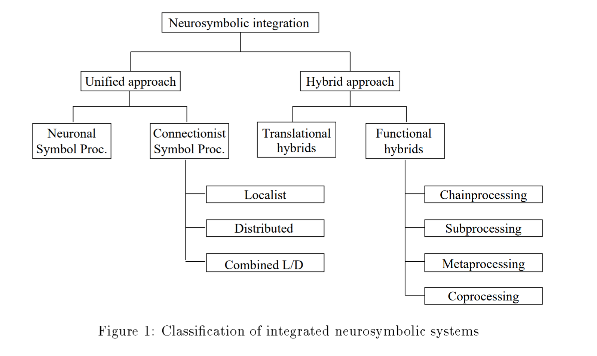
Neuro-Symbolic AI over the years
Neuro-Symbolic is a ‘fuzzy’ word.
Many different approaches over the years.
Two main types:
Unified Approach
Hybrid Approach
Image source

Slide 21
Unified vs Hybrid approach
Unified Approach
Neuronal - attempts to replicate biological neurons.
Connectionist - inspired by biological neurons but does not replicate their working.
Hybrid Approach
Functional hybrids - contains both neural and symbolic modules working together.
Translational hybrids - a mashup of both functional hybrids and a unified approach.
Image source
Notes:
Connectionist Neuronoal

Slide 22
Neuro-Symbolic AI in the 1990s
Limiting factor was on the Neural nets part.
Back propagation was relatively new and unproven.
Progress especially on the neural nets was limited due to computer power and architecture.
One approach involved: converting a symbolic program into a neural net. ^{[1]}
Successful due to the similarities between a Belief net (symbolic) and Neural Nets.

Slide 23
Neuro-Symbolic AI in the 2010s
Current generation of Neuro-Symbolic AI
Once again, different competing architectures:
Unified approach
Towards Generalizable Neuro-Symbolic Systems for Commonsense Question Answering.
RDF-to-Text Generation with Graph-augmented Structural Neural Encoders
Infusing Knowledge into the Textual Entailment Task Using Graph Convolutional Networks
Neuro-symbolic Architectures for Context Understanding
Knowledge Graph-Augmented Abstractive Summarization with Semantic-Driven Cloze Reward
Hybrid approach
Neural-Symbolic VQA: Disentangling Reasoning from Vision and Language Understanding
The Neuro-symbolic Concept Learner: Interpreting Scenes, Words, And Sentences From Natural Supervision
Visual Concept-Metaconcept Learning
Real world applications:
Cisco and SigularityNET used the OpenCog AGI engine with deep neural networks to analyze street scenes. Each camera in the system is modeled by a neural network and the symbolic layer integrates it to make sense of the whole.

Slide 24
Paper Review
Towards Generalizable Neuro-Symbolic Systems for Commonsense Question Answering. Kaixin Ma, Jonathan Francis, Quanyang Lu, Eric Nyberg and Alessandro Oltramari [ACL 2019, Hong Kong, China]
Neural-Symbolic VQA: Disentangling Reasoning from Vision and Language Understanding. Kexin Yi, Jiajun Wu, Chuang Gan, Antonio Torralba, Pushmeet Kohli DeepMind and Joshua B. Tenenbaum [NeurIPS 2018, Montréal, Canada]
The Neuro-symbolic Concept Learner: Interpreting Scenes, Words, And Sentences From Natural Supervision. Jiayuan Mao, Chuang Gan, Pushmeet Kohli, Joshua B. Tenenbaum, and Jiajun Wu [ICLR 2019, New Orleans, USA]
Visual Concept-Metaconcept Learning. Chi Han, Jiayuan Mao, Chuang Gan, Joshua B. Tenenbaum, and Jiajun Wu [NeurIPS 2019, Vancouver, Canada]

Slide 25
1. Towards Generalizable Neuro-Symbolic Systems for Commonsense Question Answering Kaixin Ma, Jonathan Francis, Quanyang Lu, Eric Nyberg, Alessandro Oltramari [ACL 2019, Hong Kong, China]
A unified approach.
Carries out a survey of the recent approaches of external knowledge-integration methods.
Trains a Neural model on Symbolic knowledge from knowledge bases.
Uses Option Comparison Network(OCN) model, which is a modification of the BERT model, to perform QA Tasks.
Knowledge bases used:
ConceptNet
ATOMIC
Methods tested:
Knowledge pre-training
Knowledge injection

Slide 26
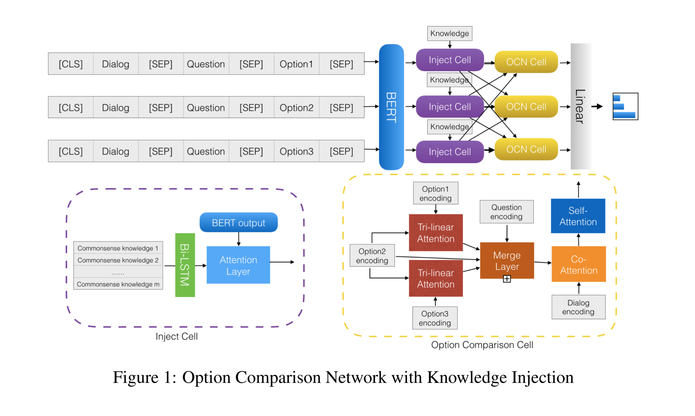
Notes:
typically solve multiple-choice QA tasks, namely by weighing each option to find correlations within them, in addition to correlations with respect to the question. To address this issue, Ran et al. (2019) introduced the Option Comparison Network (OCN) that explicitly models pairwise answer-option interactions, making OCN bettersuited for multiple-choice QA task structures. We re-implemented OCN while keeping

Slide 27
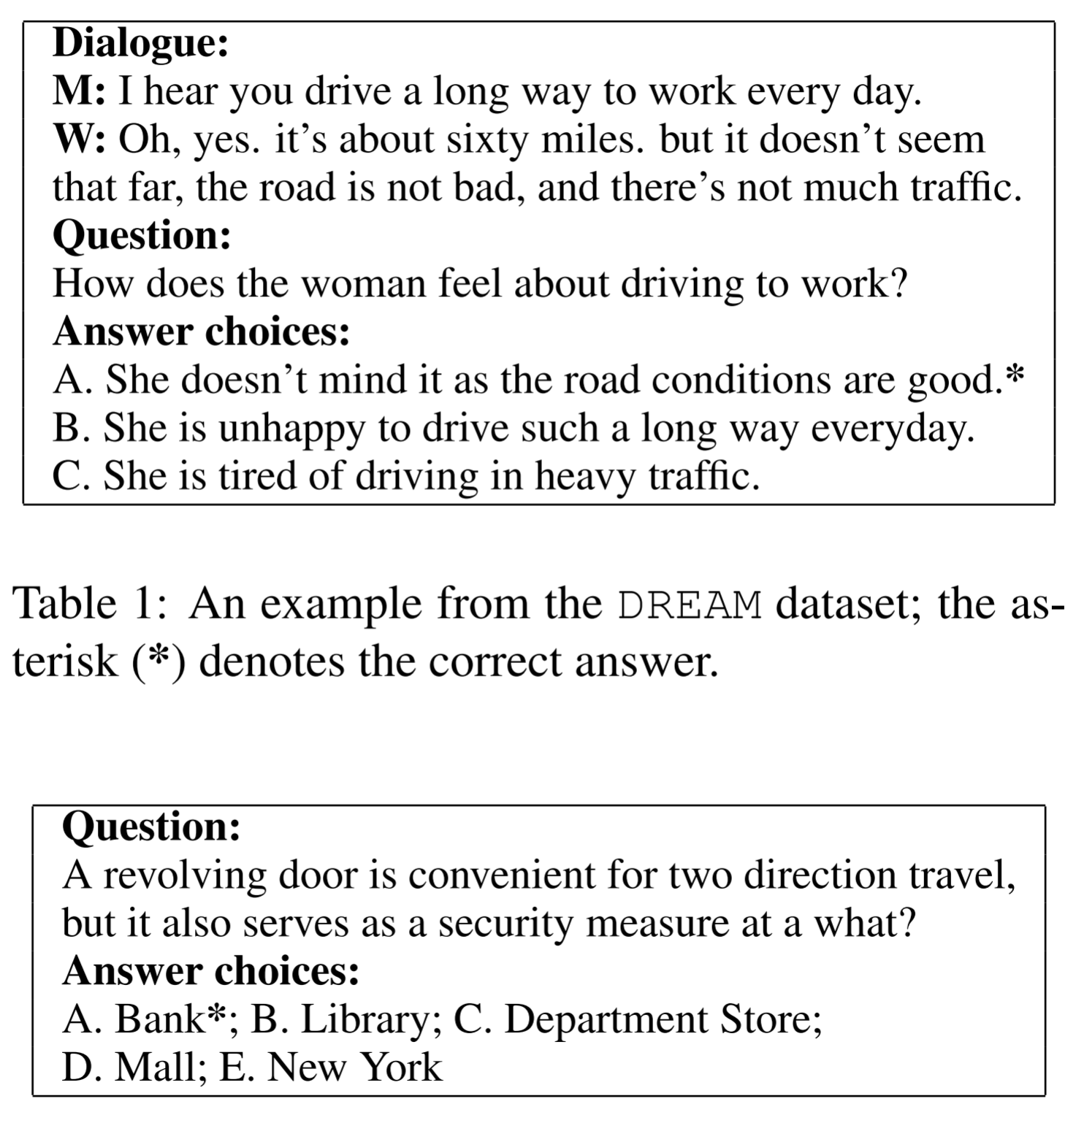
Datasets
Datasets used:
DREAM
CommonsenseQA
Complex reasoning required.
Multiple-choice questions.
Answer entailed in the question but common sense required.
Table 2: An example from the CommonsenseQA dataset; the asterisk (*) denotes the correct answer.

Slide 28
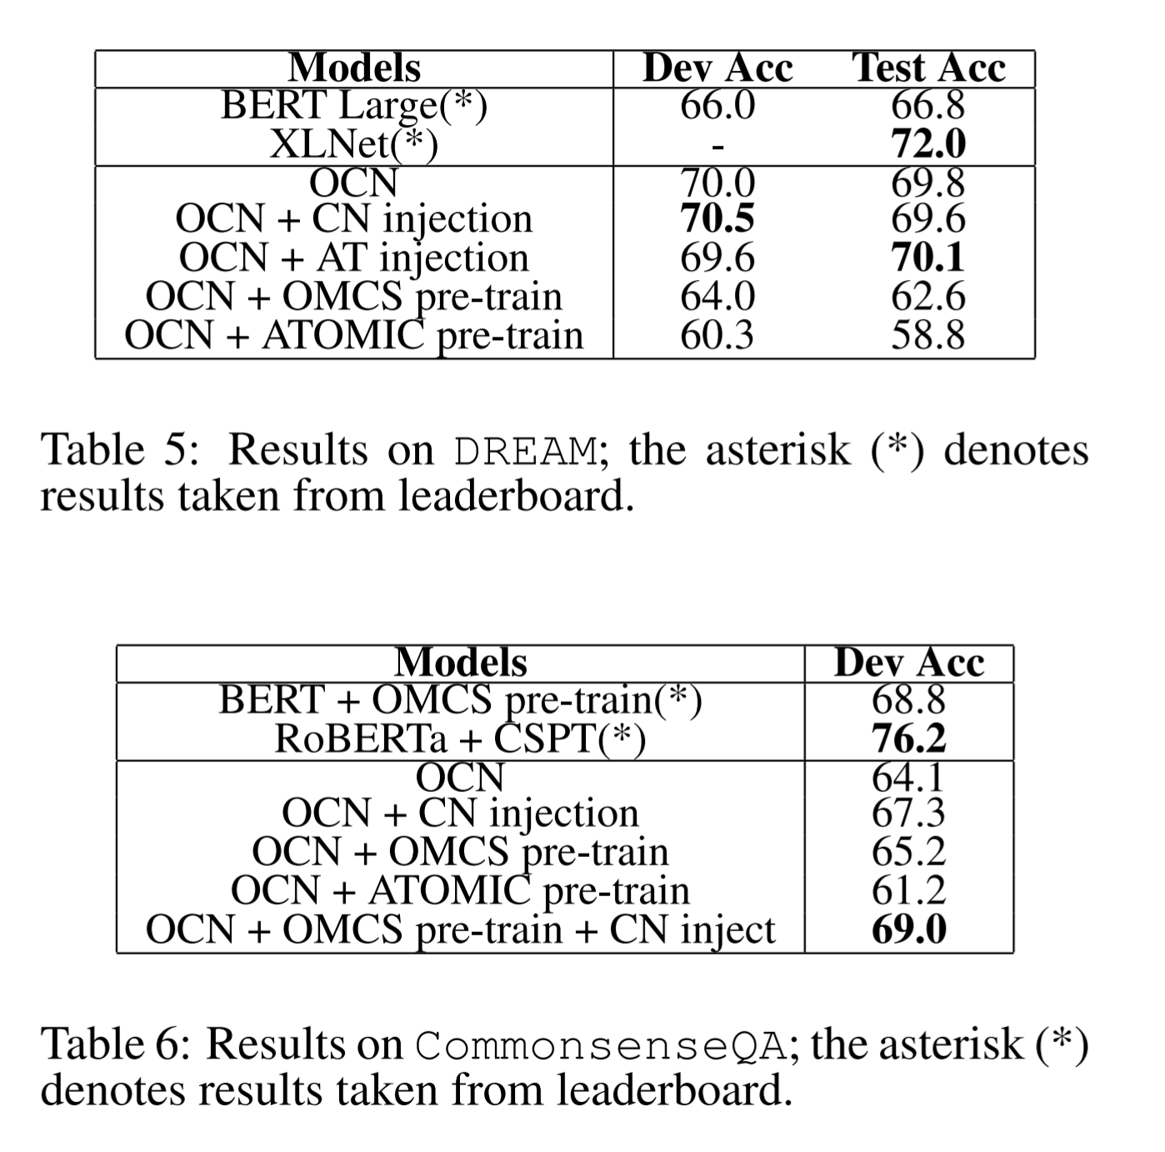
Results

Slide 29
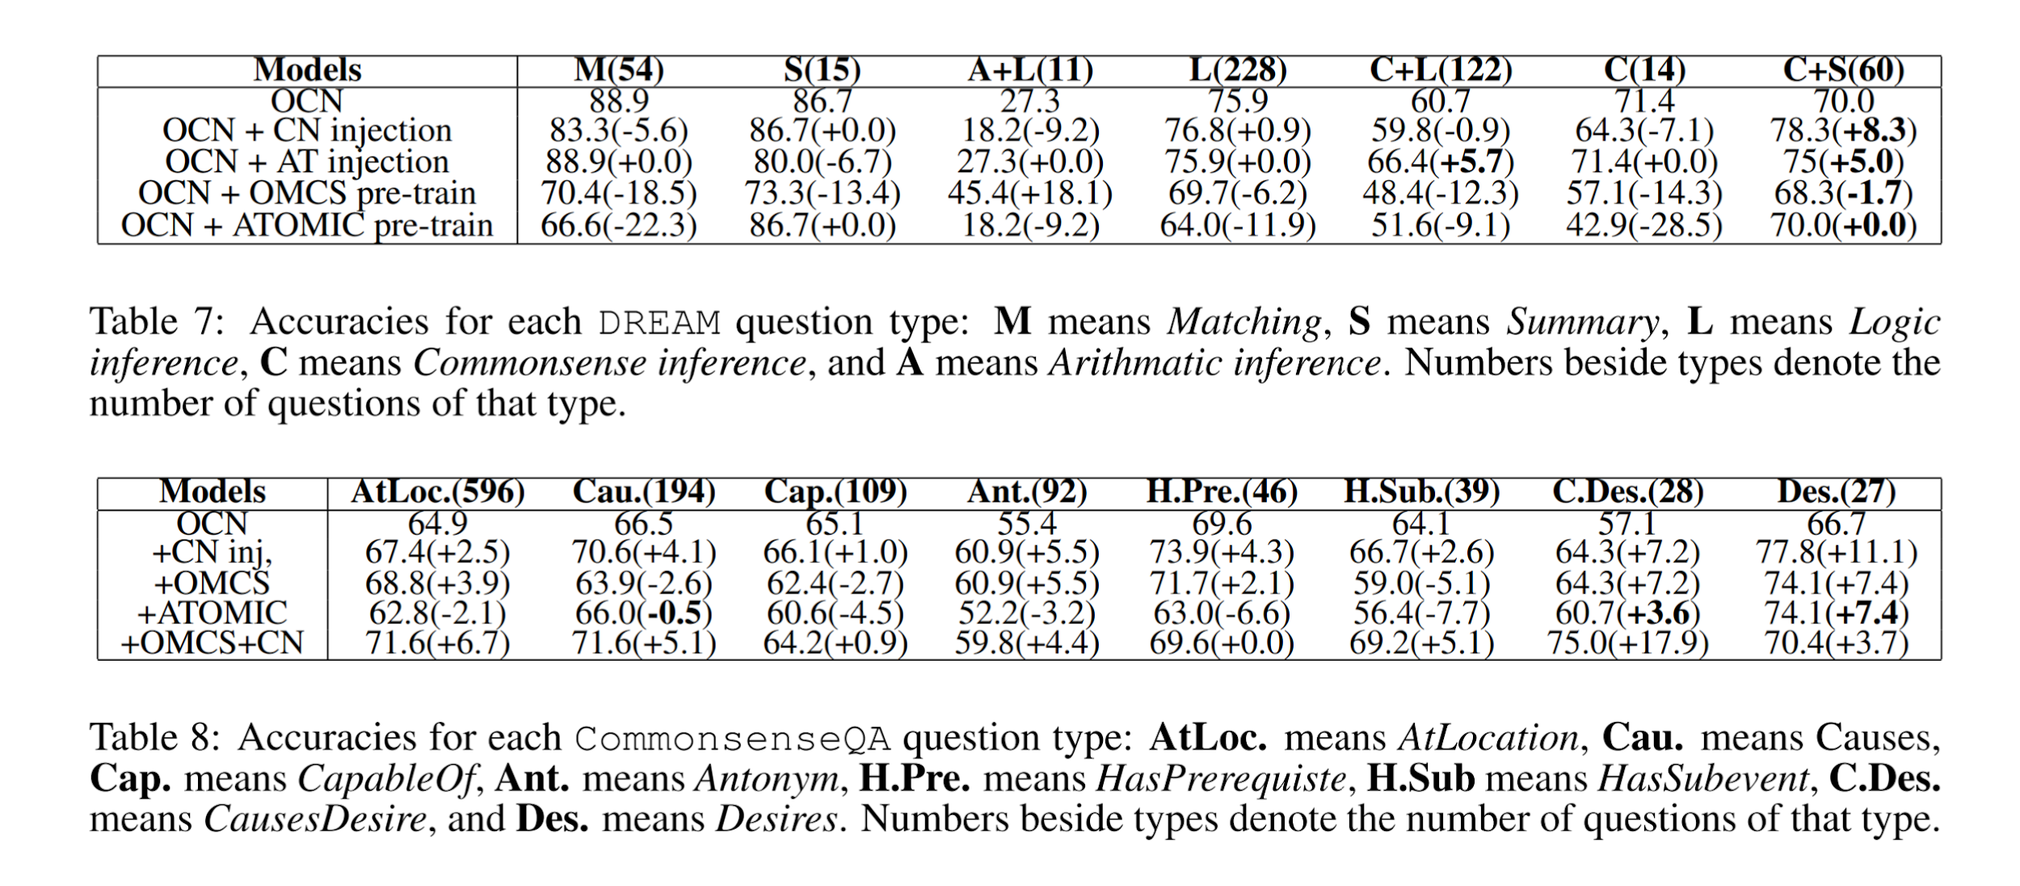
Results

Slide 30
Takeaways #1
Increased accuracy from Symbolic augmentation.
Attention-based injection seems to be a preferable choice.
Requires overlap between knowledge bases and datasets.
Training a model on a knowledge base biases the model towards that domain.

Slide 31
2. Neural-Symbolic VQA: Disentangling Reasoning from Vision and Language Understanding Kexin Yi∗ Harvard University, Jiajun Wu∗ MIT CSAIL, Chuang Gan MIT-IBM Watson AI Lab, Antonio Torralba MIT CSAIL, Pushmeet Kohli DeepMind, Joshua B. Tenenbaum MIT CSAIL [NeurIPS 2018, Montréal, Canada]
Is a hybrid approach.
Incorporates separate but linked Neural Network module and Symbolic module.
Separates Reasoning, Vision and Natural Language parsing.
Offers advantages in:
Accuracy
Few shot learning
Explainability

Slide 32
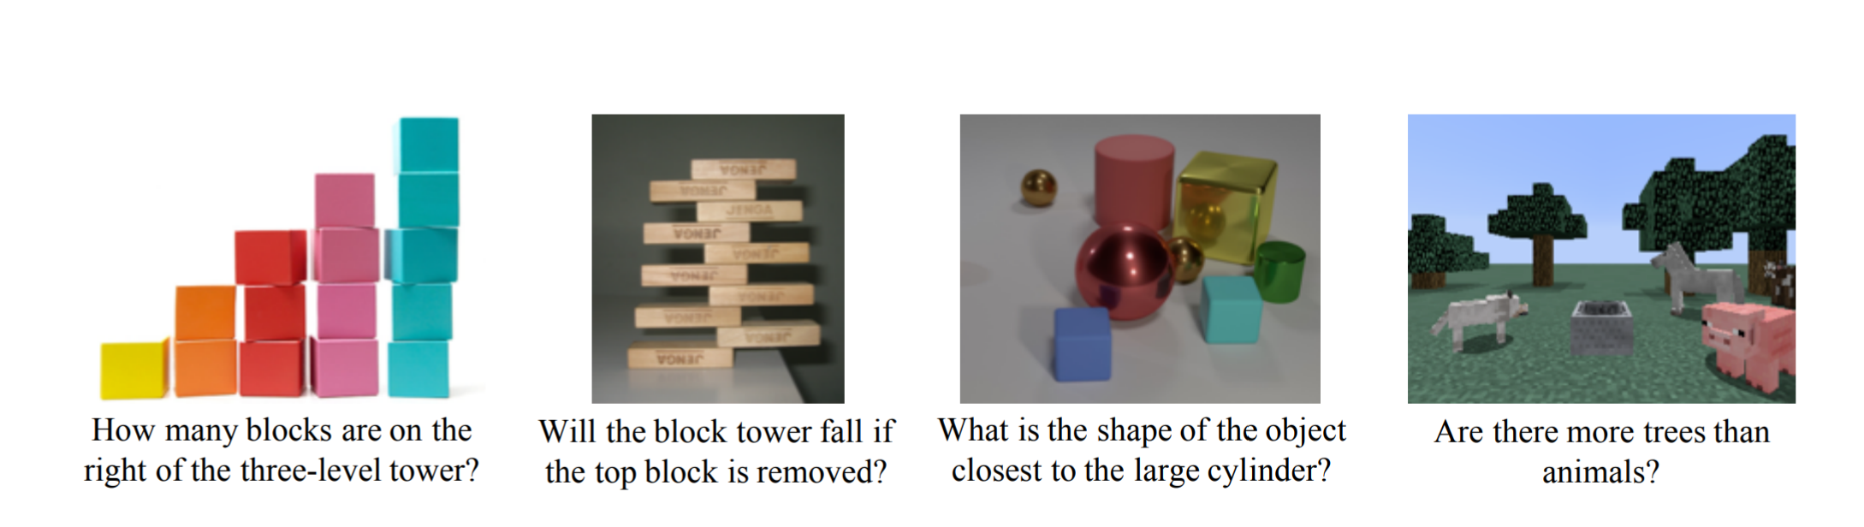

Slide 33
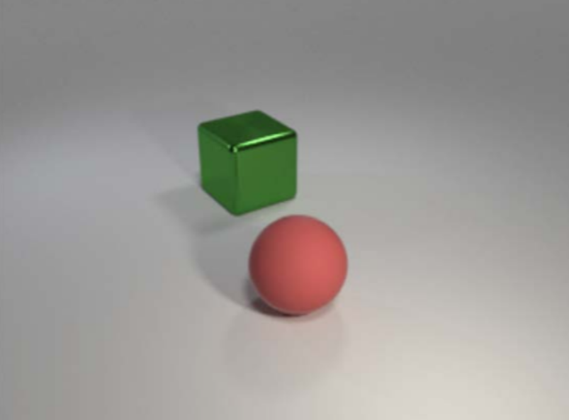
Neural-Symbolic VQA: Disentangling Reasoning from Vision and Language Understanding
End-to-end Visual Reasoning
Visual Question answering Q: What’s the shape of the red object?
End-to-end Neural Network
A: Sphere
NMN [Andreas et al., 2016] IEP [Johnson et al., 2017] FiLM [Perez et al., 2018], MAC [Hudson & Manning, 2018] Stack-NMN [Hu et al., 2018] TbD [Mascharka et al. 2018]

Slide 34
Neural-Symbolic VQA: Disentangling Reasoning from Vision and Language Understanding
End-to-end Visual Reasoning
Visual Question answering Q: What’s the shape of the red object?
Concepts (e.g colors, shape) | Reasoning (e.g count)
End-to-end Neural Network
Entangled
A: Sphere
NMN [Andreas et al., 2016] IEP [Johnson et al., 2017] FiLM [Perez et al., 2018], MAC [Hudson & Manning, 2018] Stack-NMN [Hu et al., 2018] TbD [Mascharka et al. 2018]

Slide 35
Neural-Symbolic VQA: Disentangling Reasoning from Vision and Language Understanding
End-to-end Visual Reasoning
Visual Question answering Q: What’s the shape of the red object?
Concepts (e.g colors, shape) | Reasoning (e.g count)
Neural net Identify objects and their properties | Symbolic Reason (Queries, data manipulation... )
End-to-end Neural Network
Entangled
A: Sphere
NMN [Andreas et al., 2016] IEP [Johnson et al., 2017] FiLM [Perez et al., 2018], MAC [Hudson & Manning, 2018] Stack-NMN [Hu et al., 2018] TbD [Mascharka et al. 2018]

Slide 36
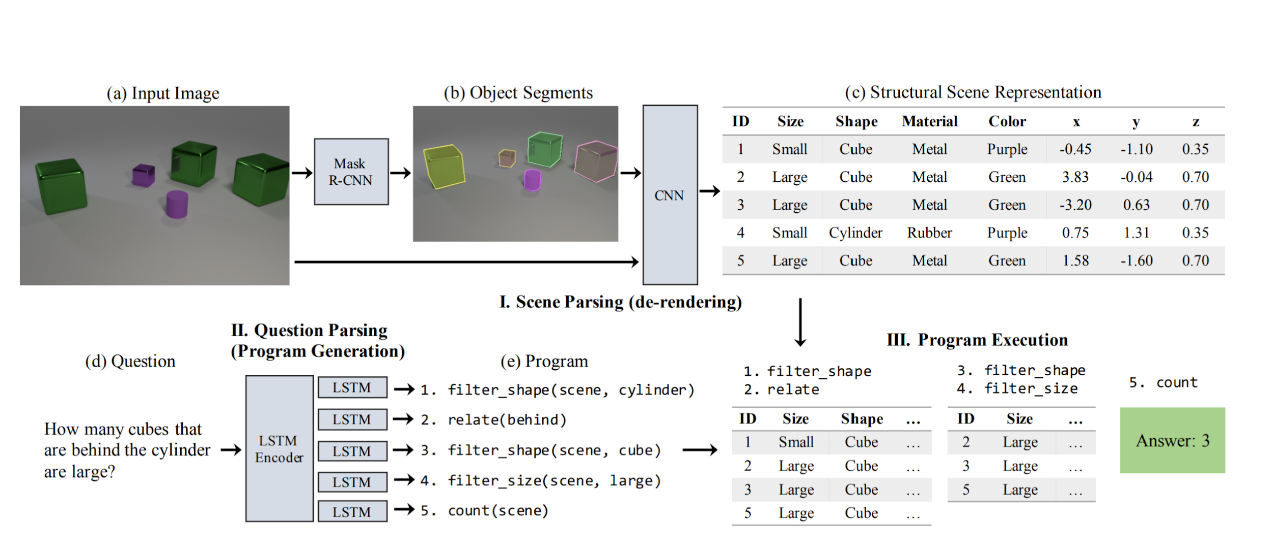
Neural-Symbolic VQA: Disentangling Reasoning from Vision and Language Understanding

Slide 37
Neural-Symbolic VQA: Disentangling Reasoning from Vision and Language Understanding
Vision CNN | Structured Representation
Language (RNN) | Symbolic Program

Slide 38
Neural-Symbolic VQA: Disentangling Reasoning from Vision and Language Understanding
Vision CNN | Structured Representation
Language (RNN) | Symbolic Program
Input image
Query in natural language
Answer

Slide 39
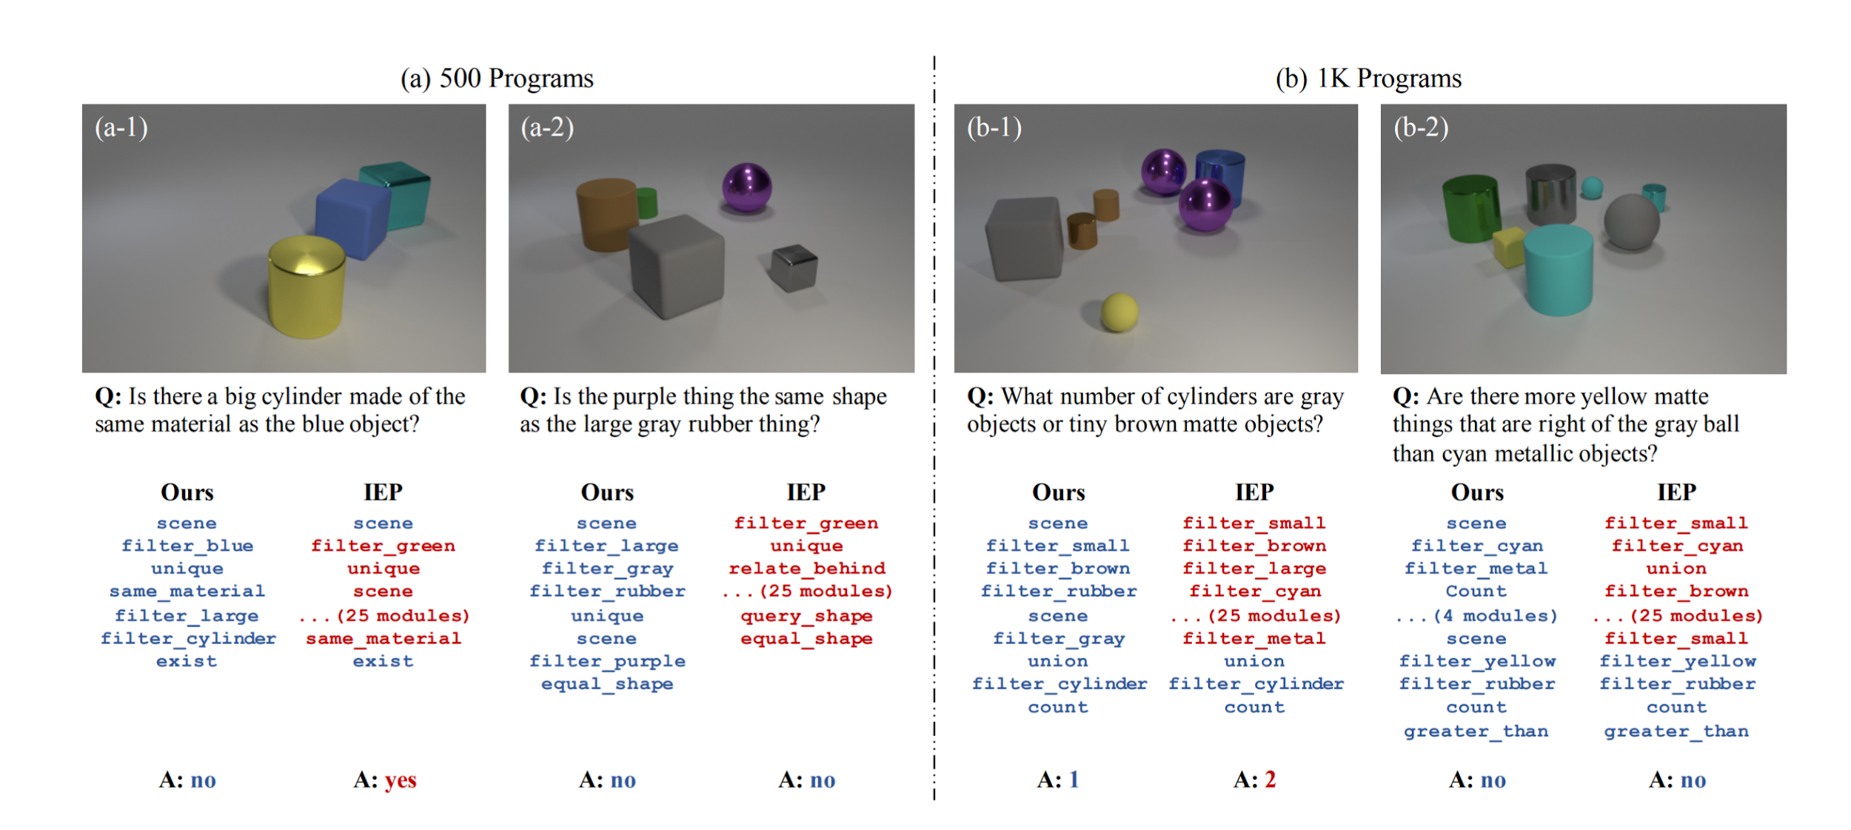

Slide 40
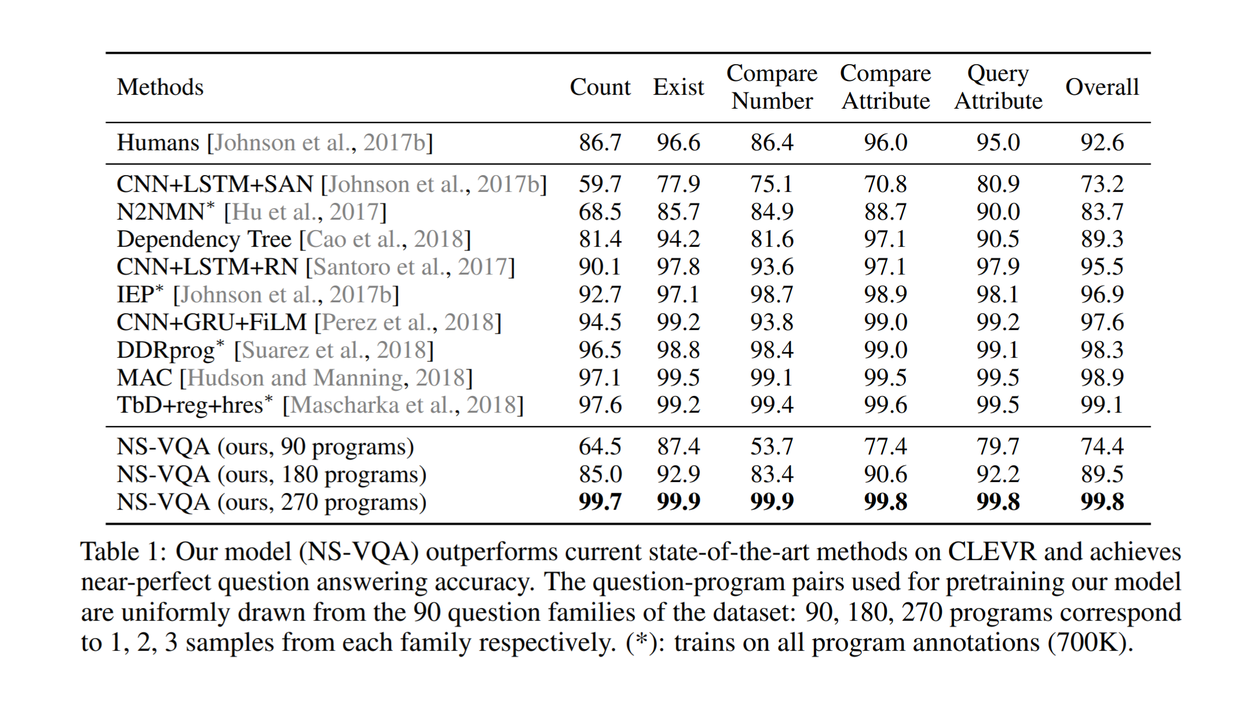
Results

Slide 41
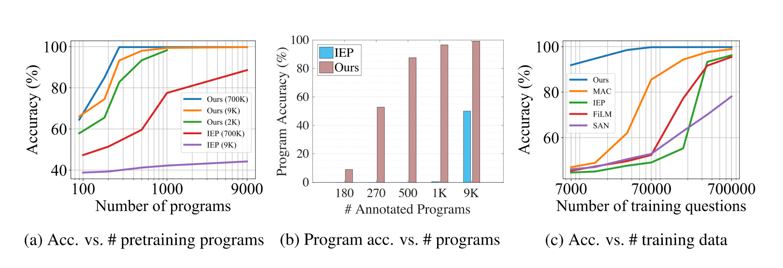
Results

Slide 42
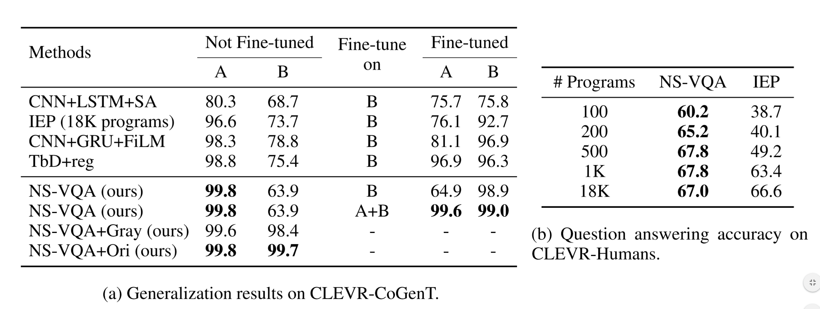
Results

Slide 43
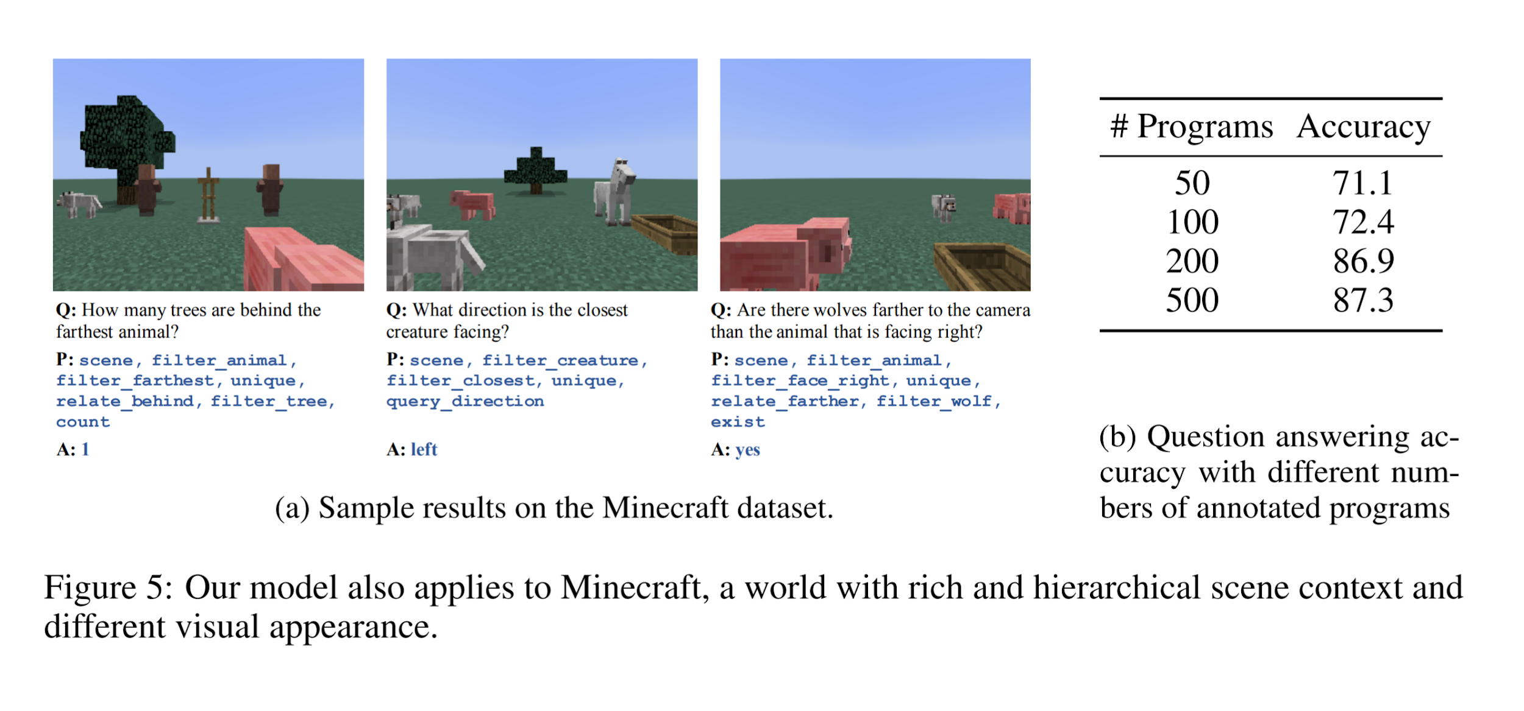
Generalizing

Slide 44
Takeaways #2
Can readily generalize.
Can perform complex reasoning.
Increased accuracy by having a Symbolic module.

Slide 45
3. The Neuro-symbolic Concept Learner: Interpreting Scenes, Words, And Sentences From Natural Supervision Jiayuan Mao MIT CSAIL and IIIS, Tsinghua University mjy14@mails.tsinghua.edu.cn, Chuang Gan MIT-IBM Watson AI Lab ganchuang@csail.mit.edu, Pushmeet Kohli Deepmind pushmeet@google.com, Joshua B. Tenenbaum MIT BCS, CBMM, CSAIL jbt@mit.edu, Jiajun Wu MIT CSAIL jiajunwu@mit.edu [ICLR 2019, New Orleans, USA]
Learns visual concepts, words, and semantic parsing of sentences without explicit supervision.
Builds an object-based scene representation and translates sentences into executable, symbolic programs.
Uses a neuro-symbolic reasoning module that executes these programs on the latent scene representation.
Uses a curriculum learning to guide the searching over the large composition space of images and language
Model learns by looking at images and reading paired questions and answers.
Modules include:
Visual perception module to construct an object-based representation for a scene.
Run a semantic parsing module to translate a question into an executable program.
Apply a quasi-symbolic program executor to infer the answer based on the scene representation.

Slide 46
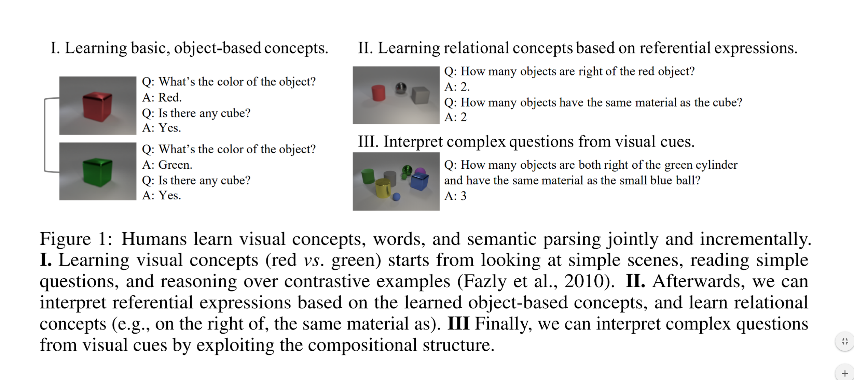
Curriculum based learning

Slide 47
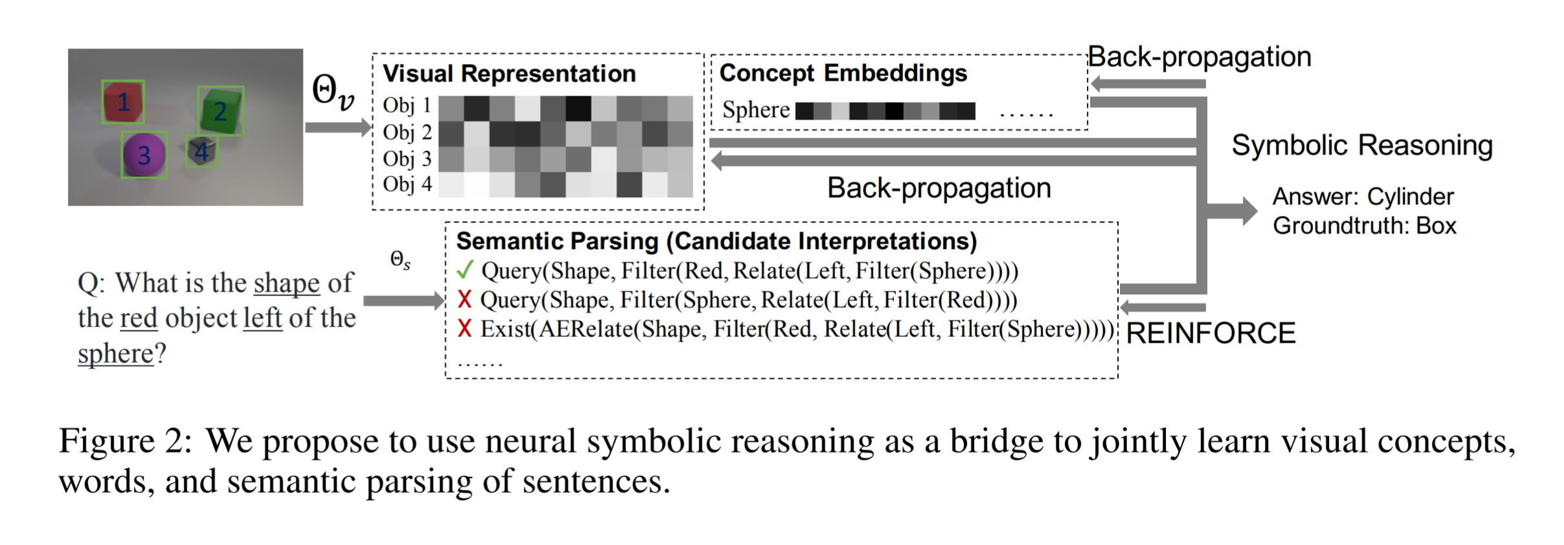
Workflow

Slide 48
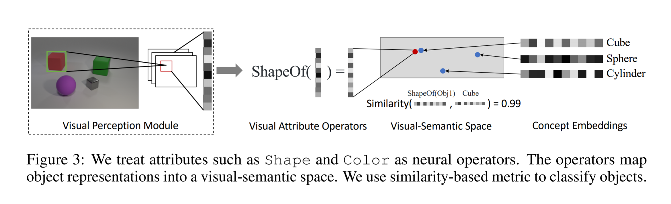
Object Representation

Slide 49
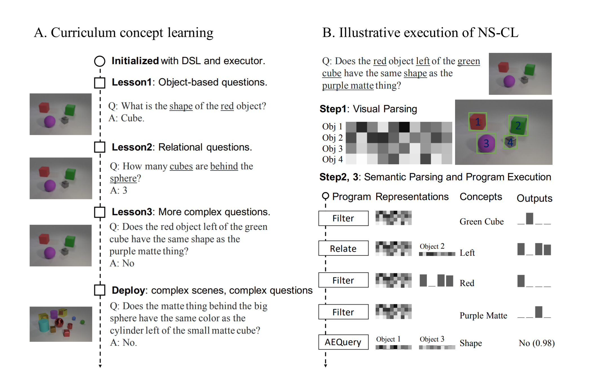

Slide 50
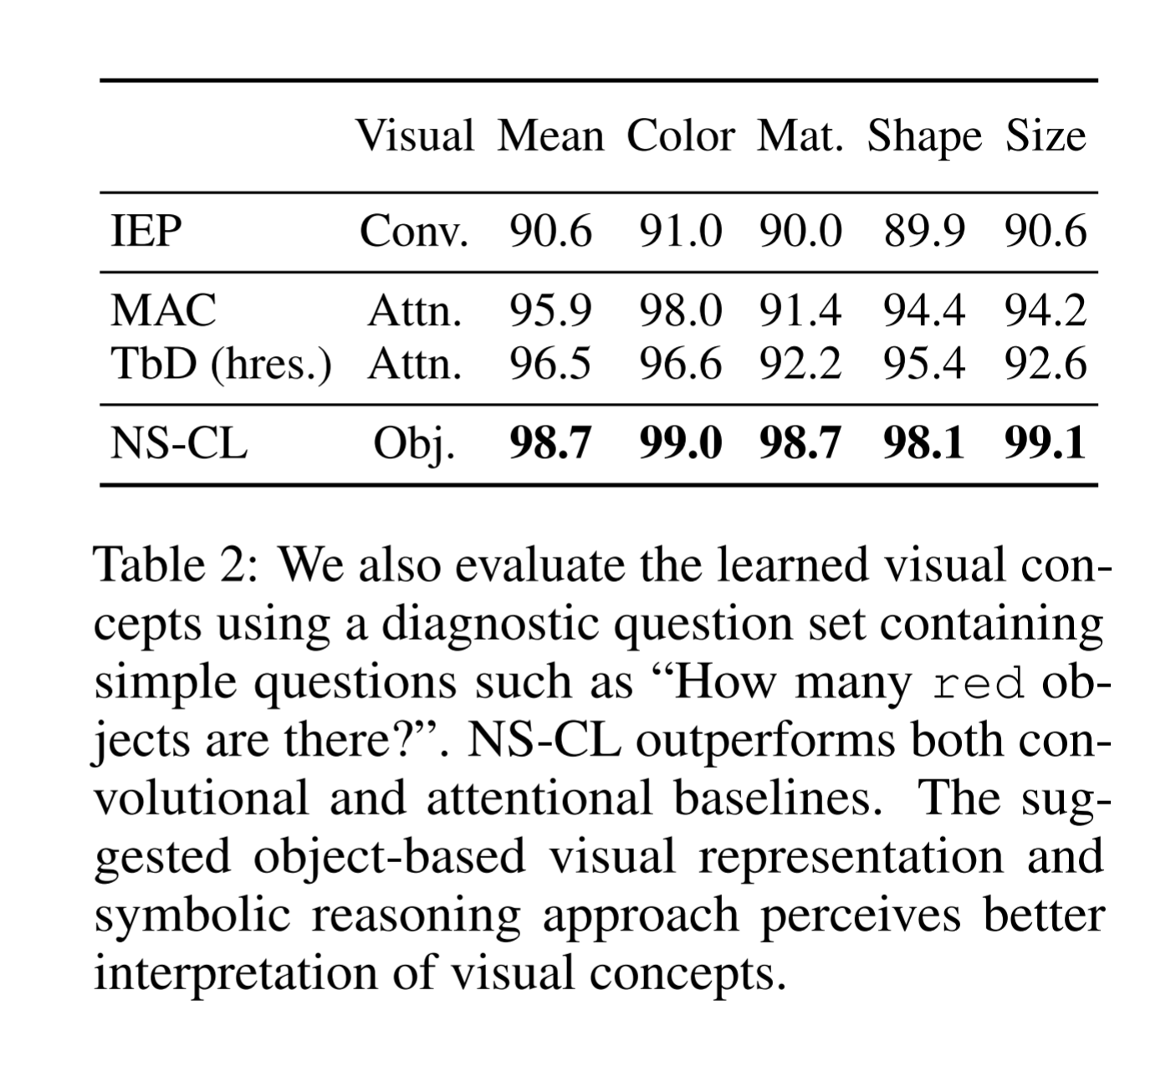
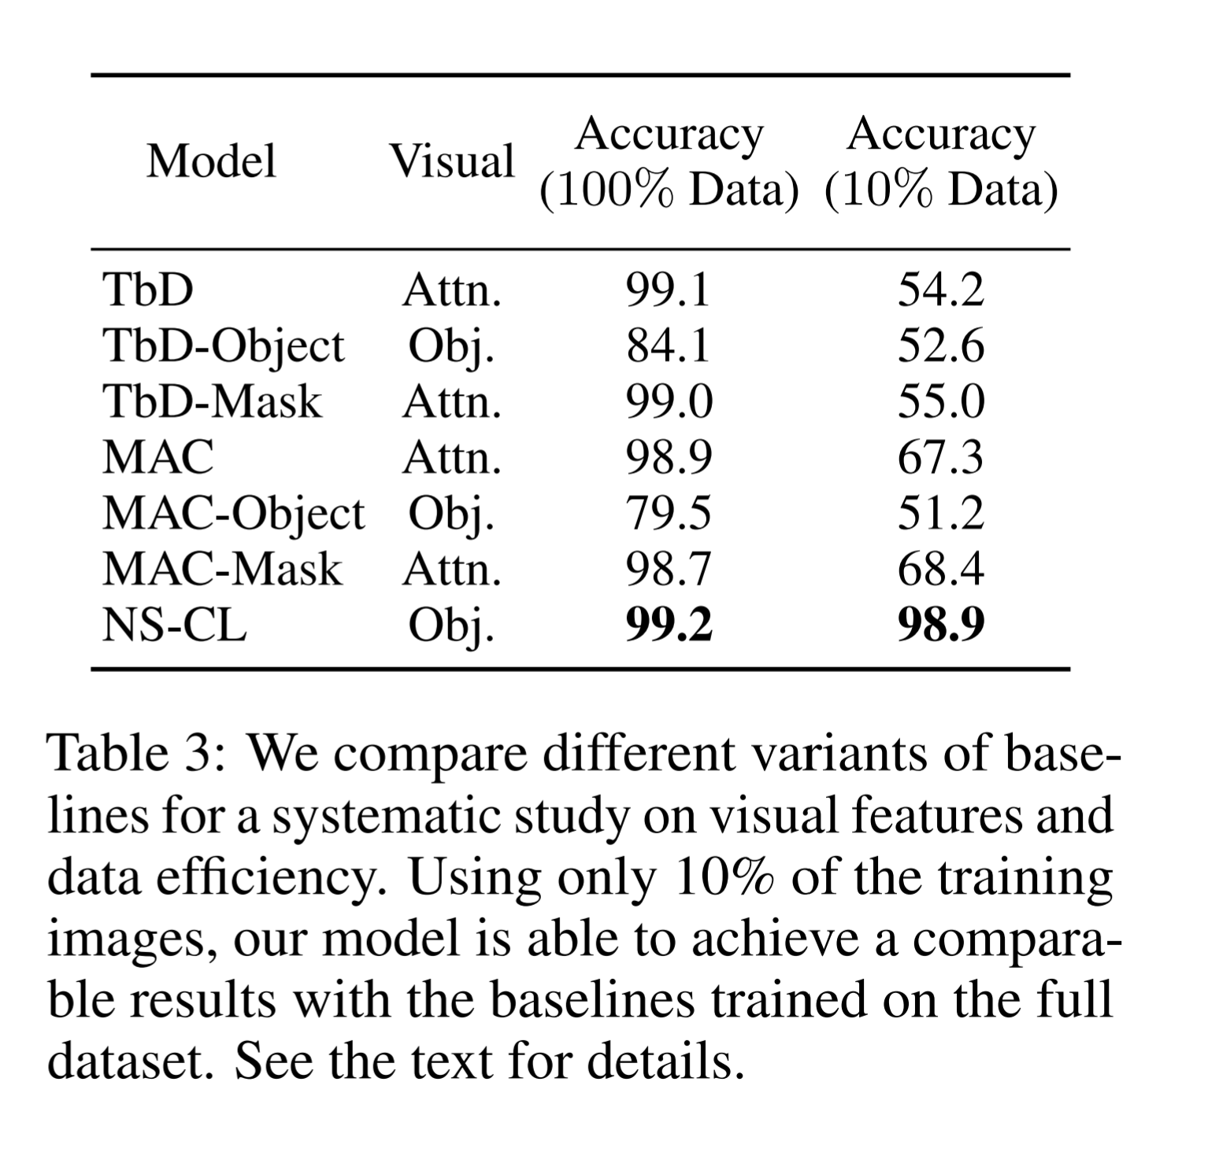
Results

Slide 51
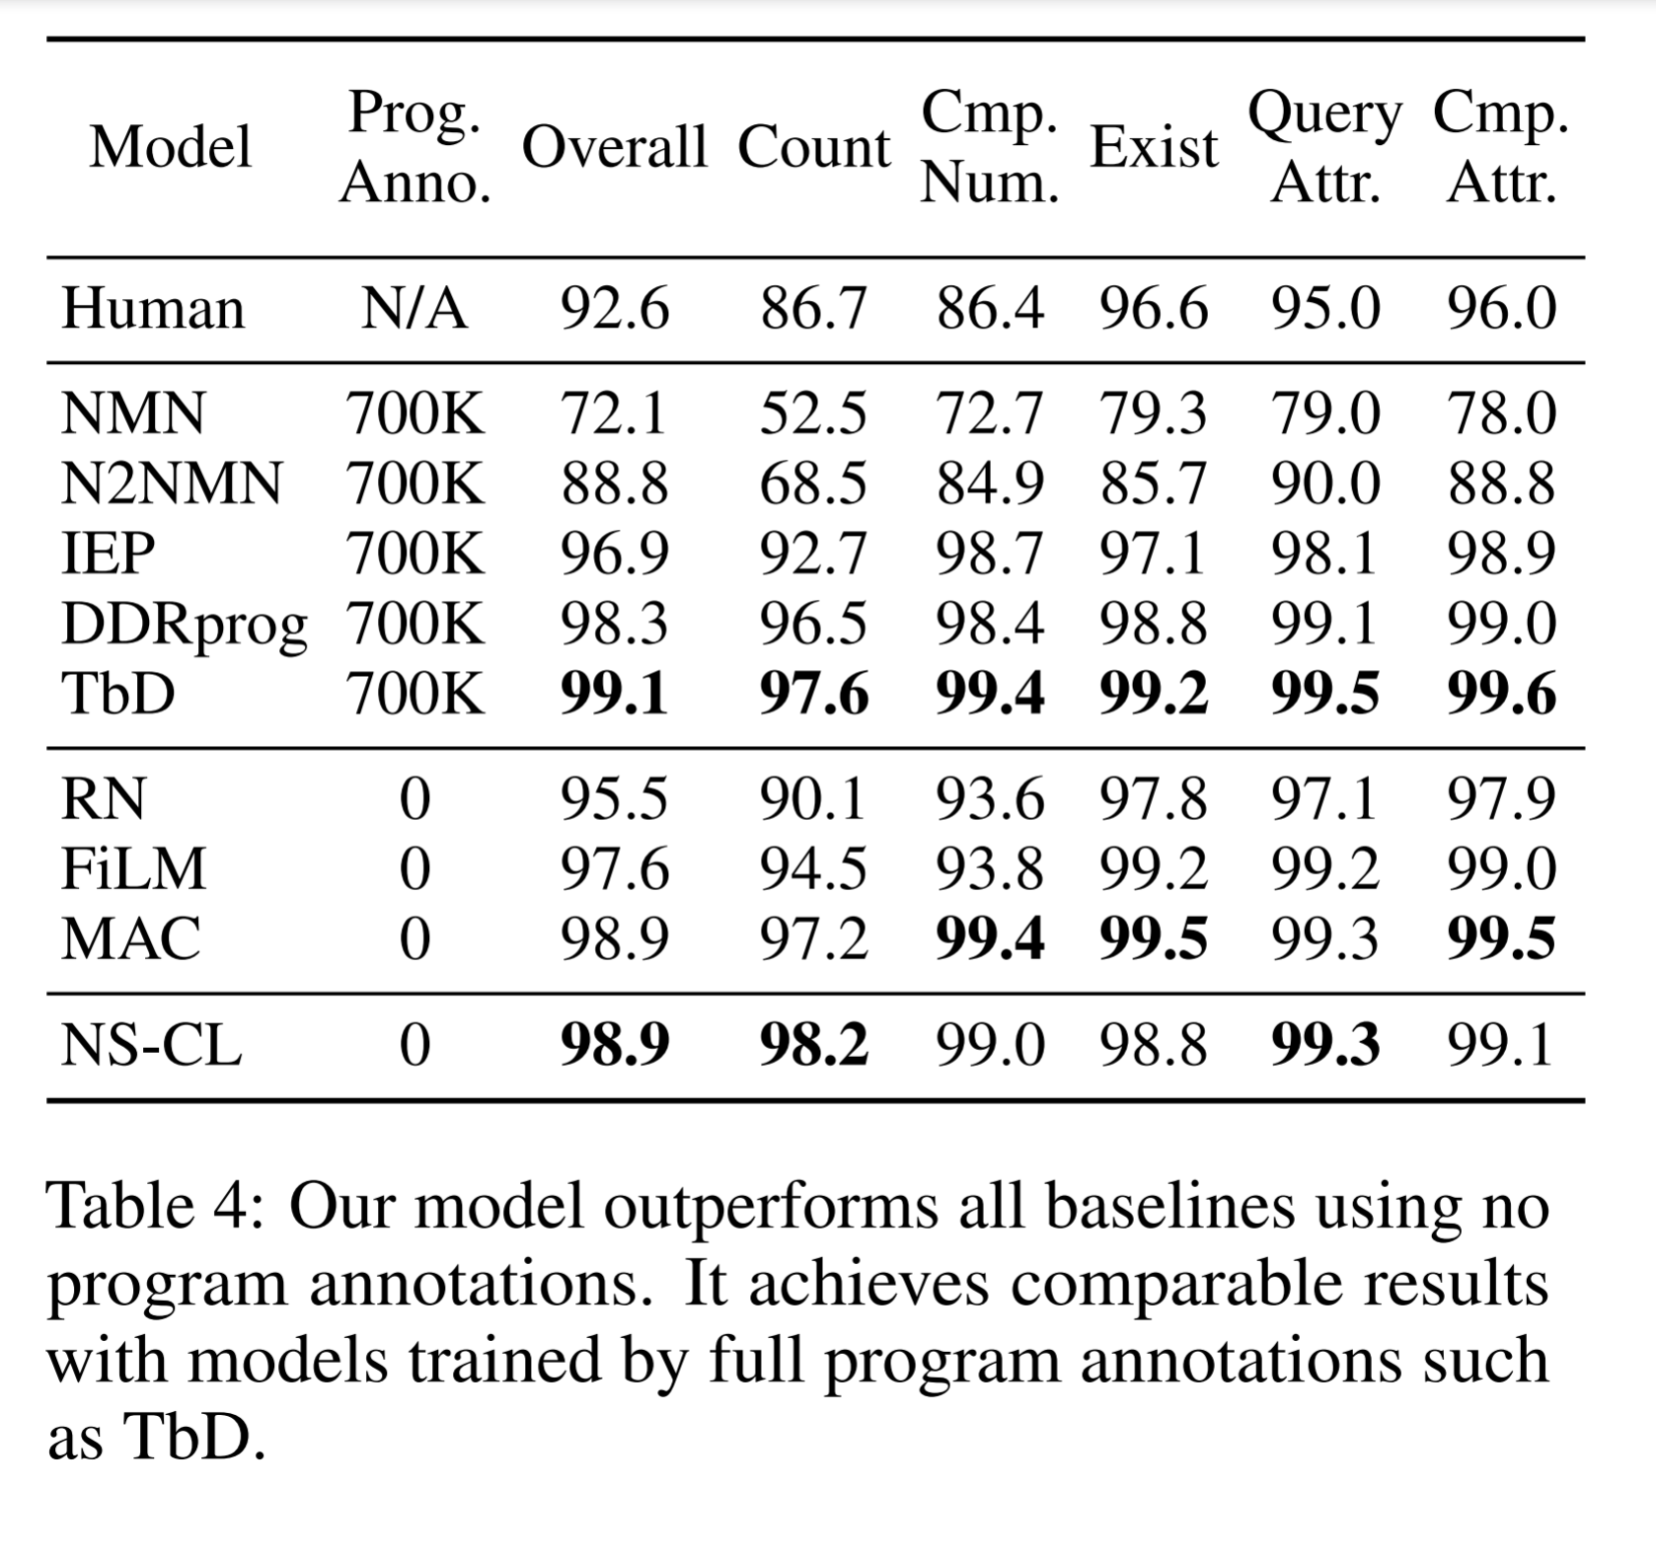
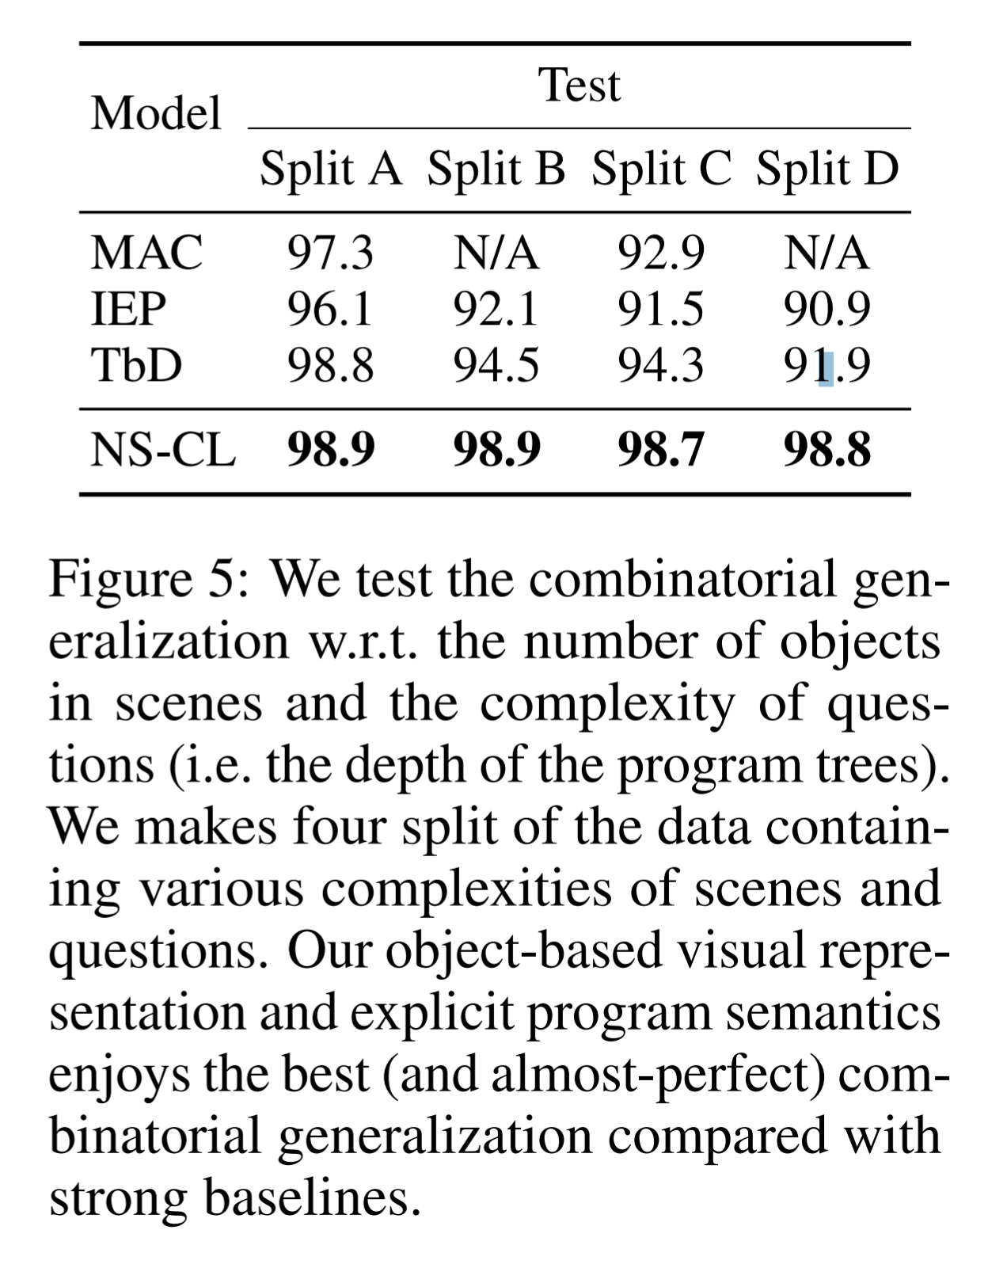
Results

Slide 52
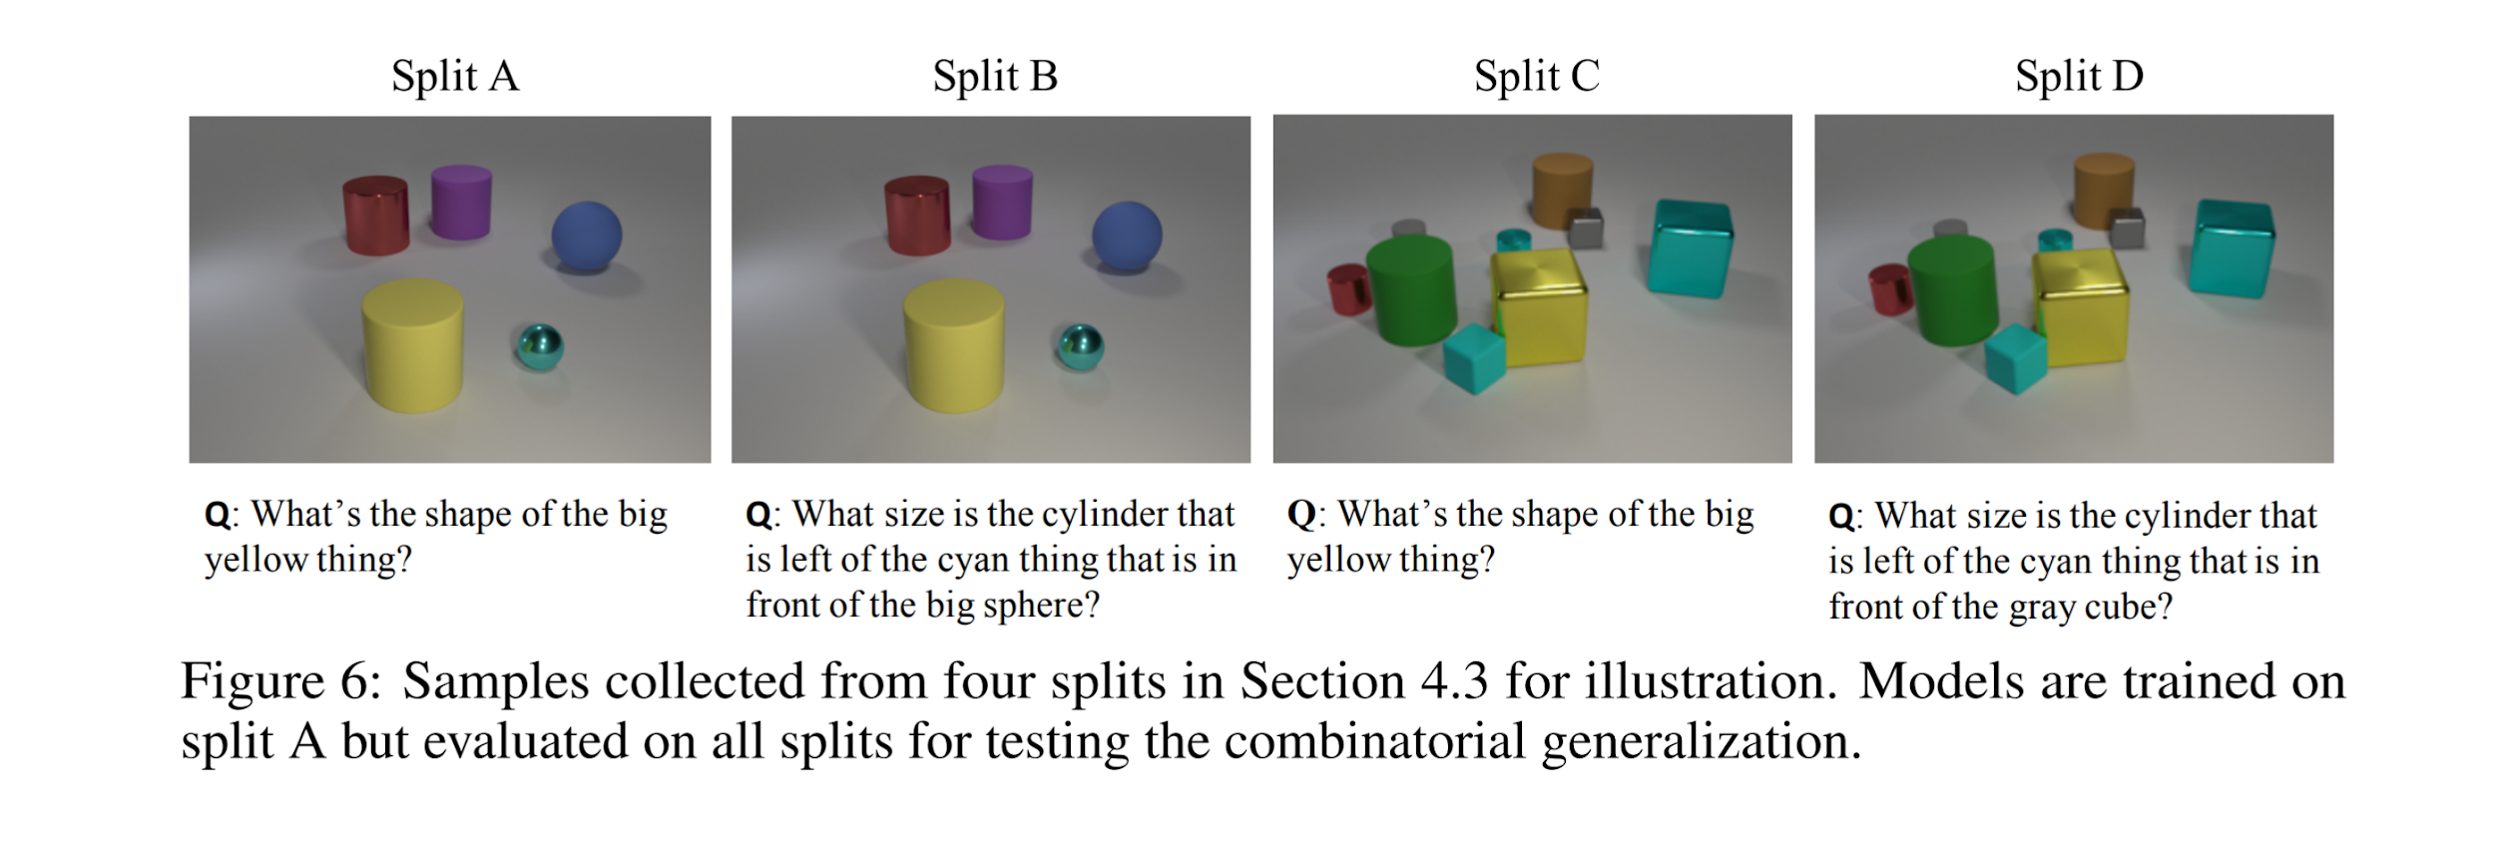
Experiments

Slide 53
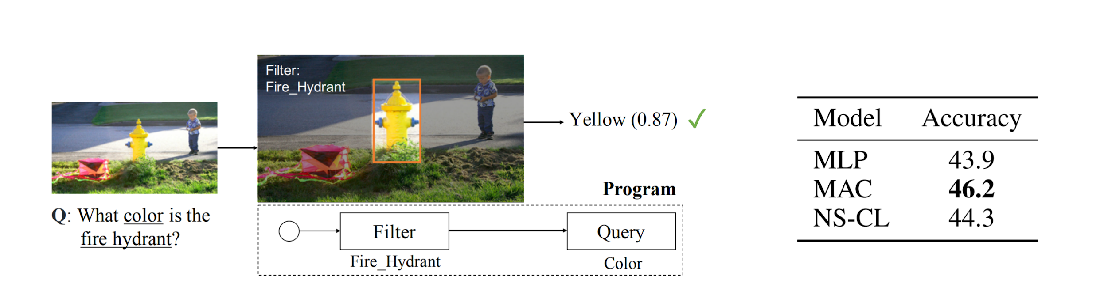
Generalization

Slide 54
Takeaways #3
Can learn new concepts from data with only semi-supervision.
Potential for curriculum learning.

Slide 55
4. Visual Concept-Metaconcept Learning Chi Han∗ MIT CSAIL and IIIS, Tsinghua University, Jiayuan Mao∗ MIT CSAIL, Chuang Gan MIT-IBM Watson AI Lab, Joshua B. Tenenbaum MIT BCS, CBMM, CSAIL, Jiajun Wu MIT CSAIL [NeurIPS 2019, Vancouver, Canada]
Proposes a joint concept and meta-concept learning from images and associated question-answer pairs.
Exploits the bidirectional connection between visual concepts and metaconcepts.
Visual representations provide grounding cues for predicting relations between unseen pairs of concepts.
Example: Knowing that red and green describe the same property of objects, the model generalizes to the fact that cube and sphere also describe the same property of objects.
Knowledge about metaconcepts empowers visual concept learning from limited, noisy, and even biased data.
Has the following modules: the object proposal generator, object representations, the semantic parser, concept embeddings

Slide 56
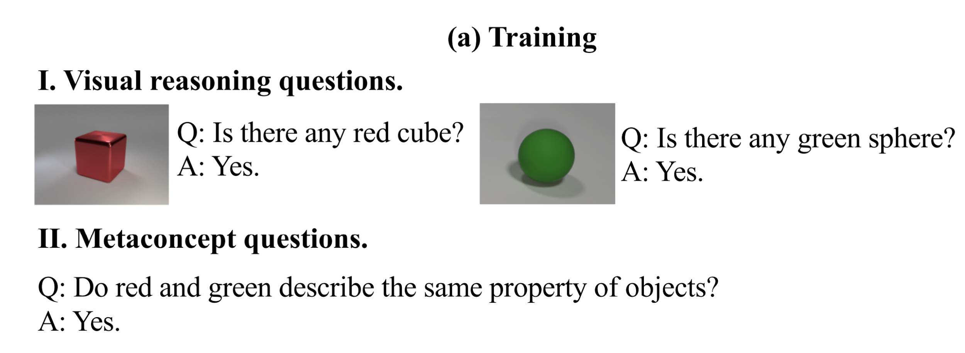
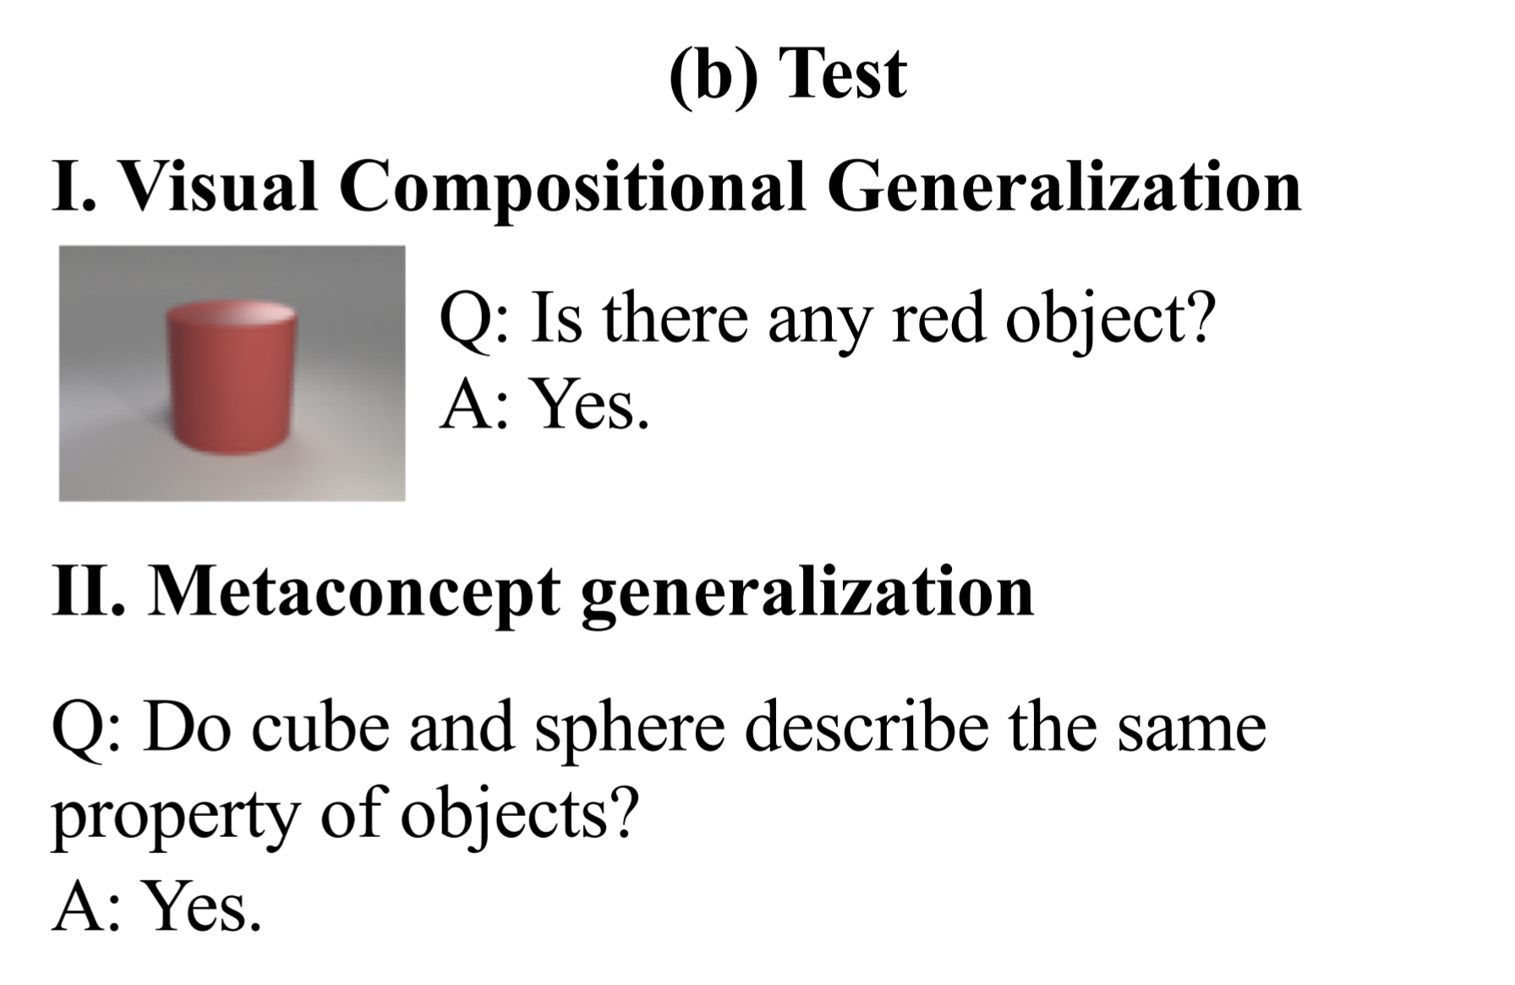
Experiments

Slide 57
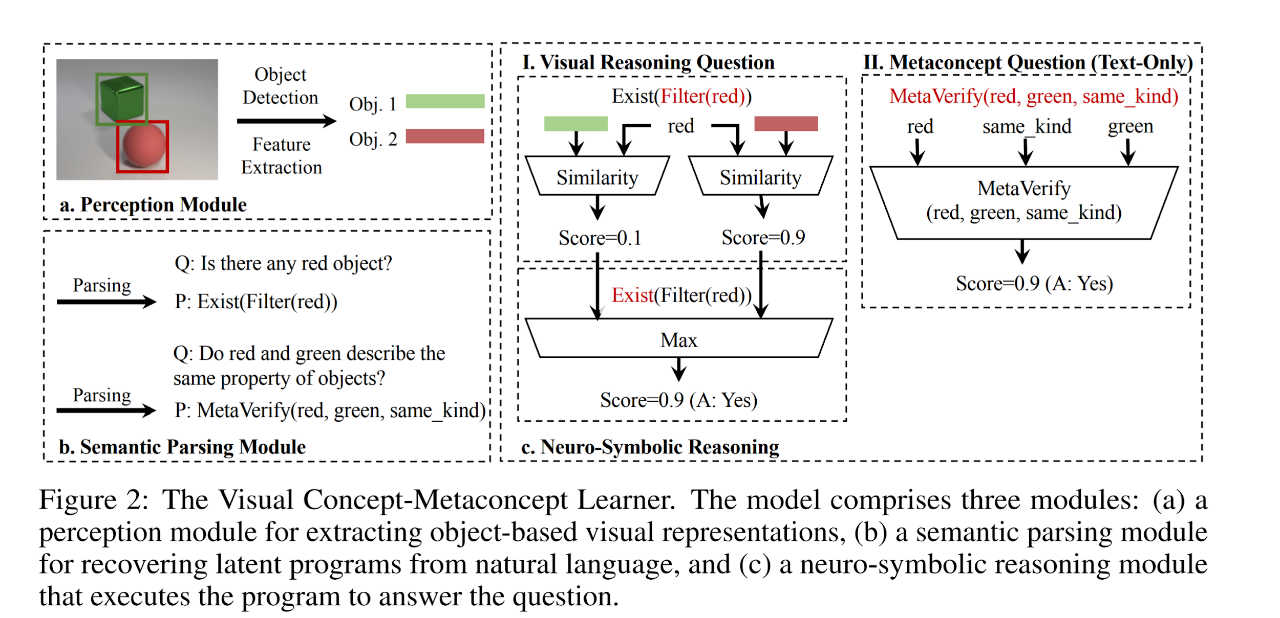

Slide 58
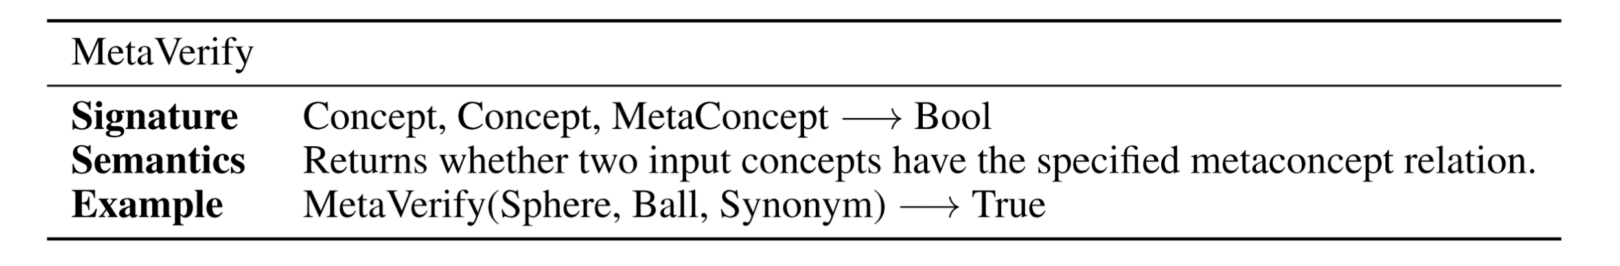
Meta-concepts
Introduces Meta-concept operator.
Small Neural nets acting on the Concept Net act as the Meta-concept operator mapping a meta-concept to the concept-metaconcept embedding space.

Slide 59
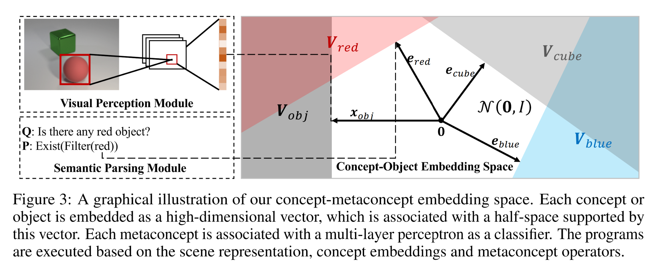
Concept Space

Slide 60
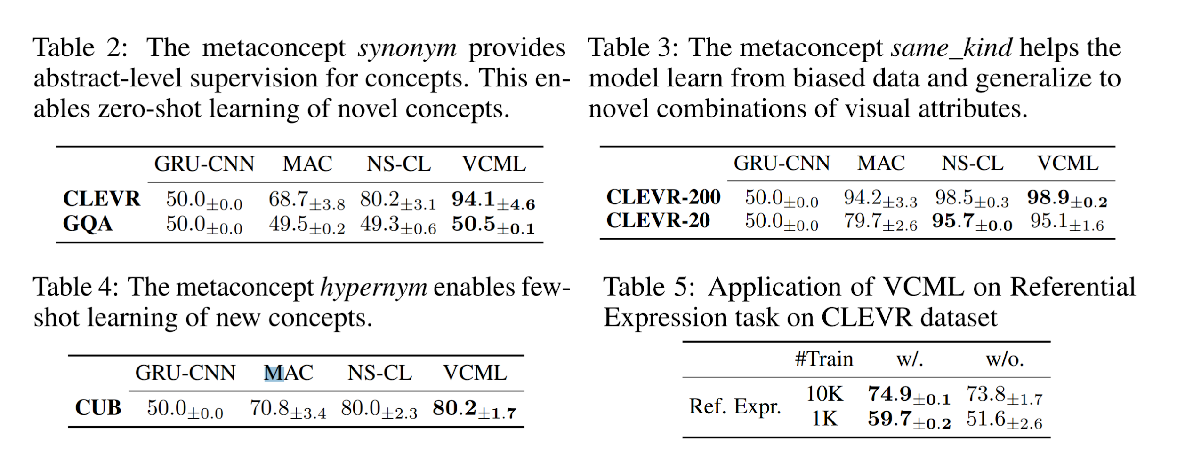
Results

Slide 61
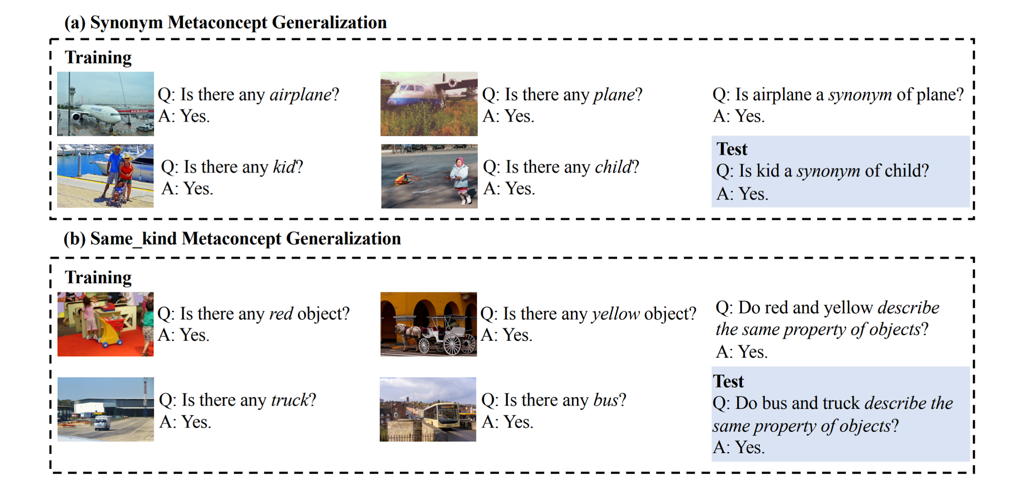
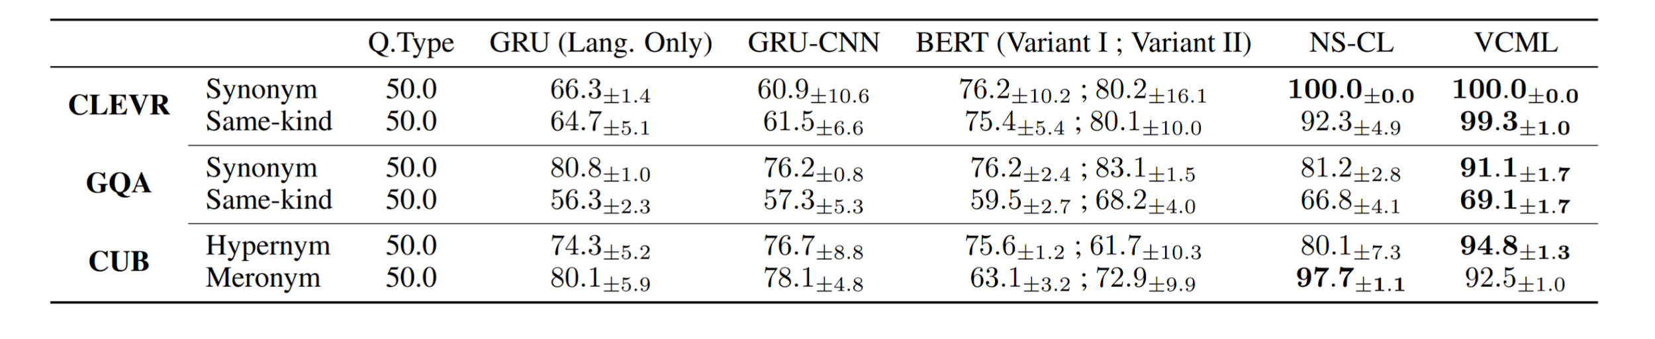

Slide 62
Takeaways #4
Can learn new concepts and meta-concepts unsupervised.
Connecting visual concepts and abstract relational meta-concepts leads to improvement in both.

Slide 63
Discussion #1
What are other potential applications of Neuro-Symbolic AI?

Slide 64
Discussion #2
In what other ways can the two approaches, Symbolic systems and Neural Networks, be integrated?

Slide 65
Discussion #3
Which Neuro-Symbolic approach do you prefer? A. Symbolic knowledge integrated in Neural Nets
B. Systems with separate but linked Neural Nets and Symbolic modules.
C. Other

Slide 66
Discussion #4
In your opinion, do you think that Neuro-Symbolic systems will be necessary to get better AI systems in the future? Please give a reason for your answer.

Slide 67
Additional Resources
Papers
Infusing Knowledge into the Textual Entailment Task Using Graph Convolutional Networks
Towards Deep Symbolic Reinforcement Learning
Links
https://www.digitaltrends.com/cool-tech/neuro-symbolic-ai-the-future/
https://jrmerwin.github.io/deeplearning4j-docs/symbolicreasoning.html
https://becominghuman.ai/where-is-artificial-intelligence-used-today-3fd076d15b68

Slide 68
References
Kaixin Ma, Jonathan Francis, Quanyang Lu, Eric Nyberg and Alessandro Oltramari. Towards Generalizable Neuro-Symbolic Systems for Commonsense Question Answering. [ACL 2019, Hong Kong, China]
Kexin Yi, Jiajun Wu, Chuang Gan, Antonio Torralba, Pushmeet Kohli DeepMind and Joshua B. Tenenbaum. Neural-Symbolic VQA: Disentangling Reasoning from Vision and Language Understanding. [NeurIPS 2018, Montréal, Canada]
Jiayuan Mao, Chuang Gan, Pushmeet Kohli, Joshua B. Tenenbaum, and Jiajun Wu. The Neuro-symbolic Concept Learner: Interpreting Scenes, Words, And Sentences From Natural Supervision. [ICLR 2019, New Orleans, USA]
Chi Han, Jiayuan Mao, Chuang Gan, Joshua B. Tenenbaum, and Jiajun Wu. Visual Concept-Metaconcept Learning [NeurIPS 2019, Vancouver, Canada]

